Slide 1
Introduction to deep learning – Final project
Orin Brown

Slide 2
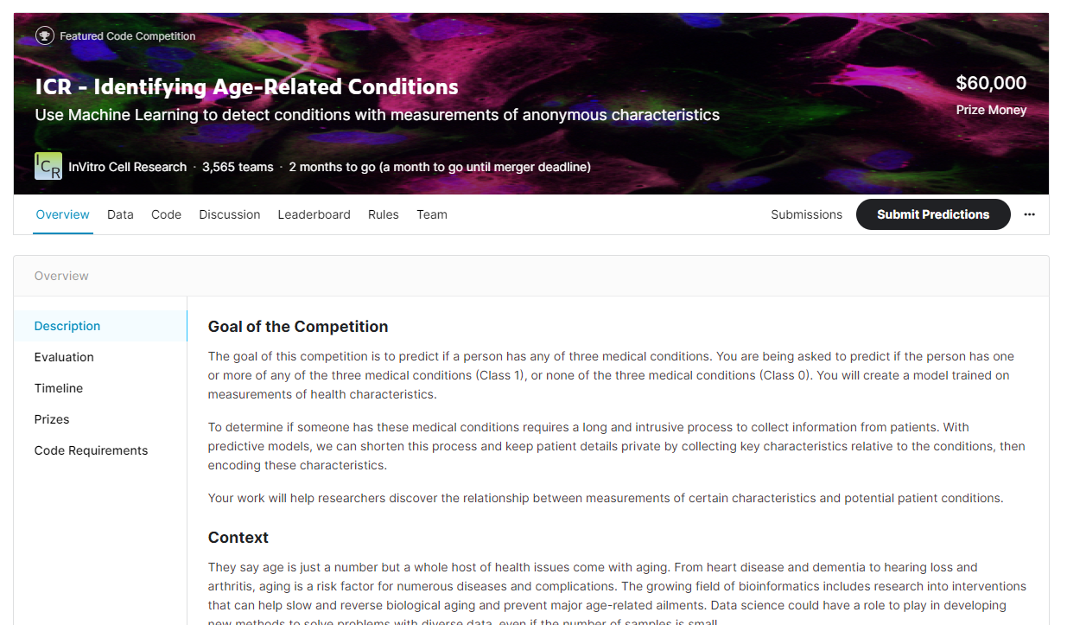
Problem statement

Slide 3
Problem statement
Binary Classification
The goal of this competition is to predict if a person has any of three medical conditions. You are being asked to predict if the person has one or more of any of the three medical conditions (Class 1), or none of the three medical conditions (Class 0). You will create a model trained on measurements of health characteristics.
To determine if someone has these medical conditions requires a long and intrusive process to collect information from patients. With predictive models, we can shorten this process and keep patient details private by collecting key characteristics relative to the conditions, then encoding these characteristics.

Slide 4
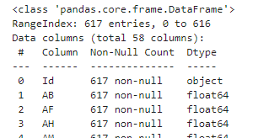
EDA - Inspection
Id: Unique identifier for each observation.
AB-GL: Fifty-six anonymized health characteristics. All are numeric except for EJ, which is categorical
Class: A binary target: 1 indicates the subject has been diagnosed with one of the three conditions, 0 indicate they have not.

Slide 5
EDA - Procedure
Encode EJ, transform letters to numbers.
Check for missing or null values.
Fix missing values by imputing column means.
Normalize by column.
Remove outliers
Use hierarchical clustering to combine highly correlated columns.

Slide 6

EDA - normalization
5 order of magnitude difference between columns.
Data was normalized so different columns could be meaningfully compared.

Slide 7
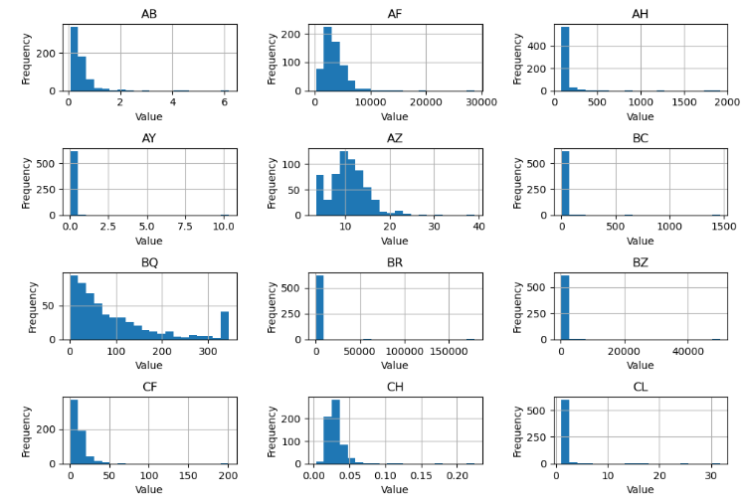
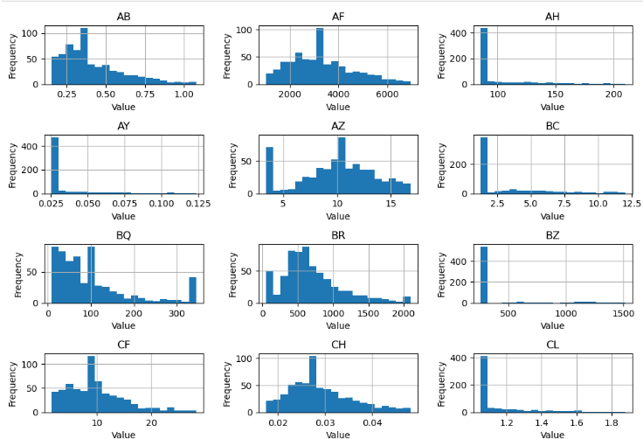
EDA - Outliers

Slide 8
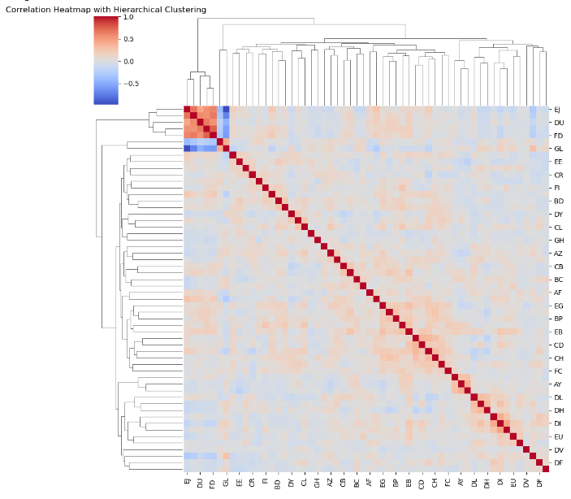
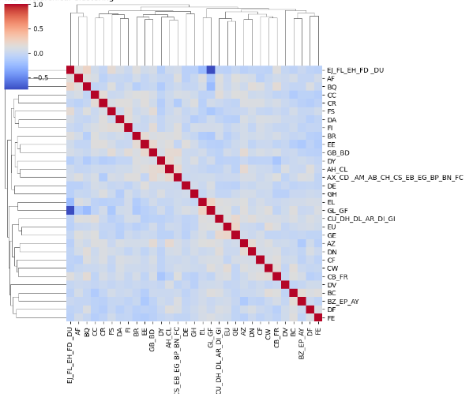
EDA - Clustering
Before Clustering
After Clustering

Slide 9
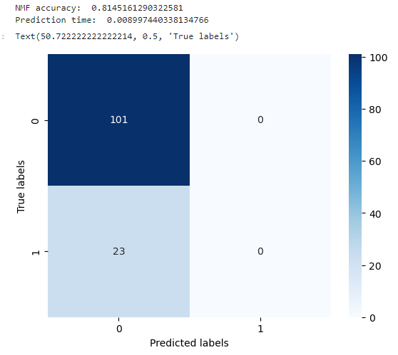
Modeling Non-negative Matrix Factorization (NMF)

Slide 10
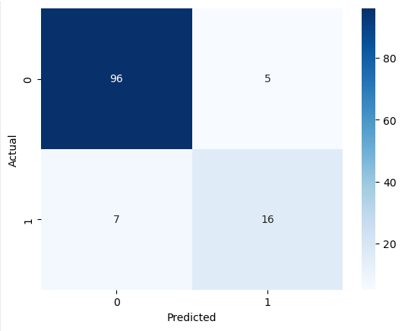
Modeling – Multilayer perceptron

Slide 11


Modeling – Linear regression and GAM
Linear Regression
GAM

Slide 12
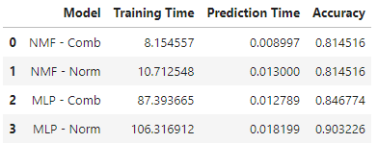
Results

